Slide 1

Virtual Simulation for Testing a Vision-Based Autonomous Docking and Navigation Algorithm
MAE 252 – Autonomous Robotics
John Karasinski
Chris Lorenzen
Melanie Stich
University of California, Davis – Department of Mechanical & Aerospace Engineering
March 9, 2015

Slide 2
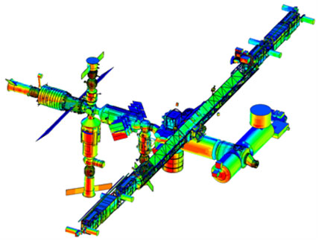
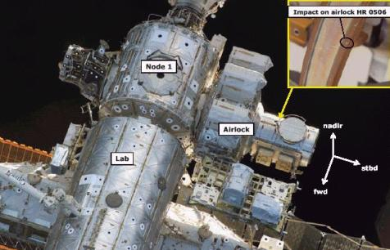
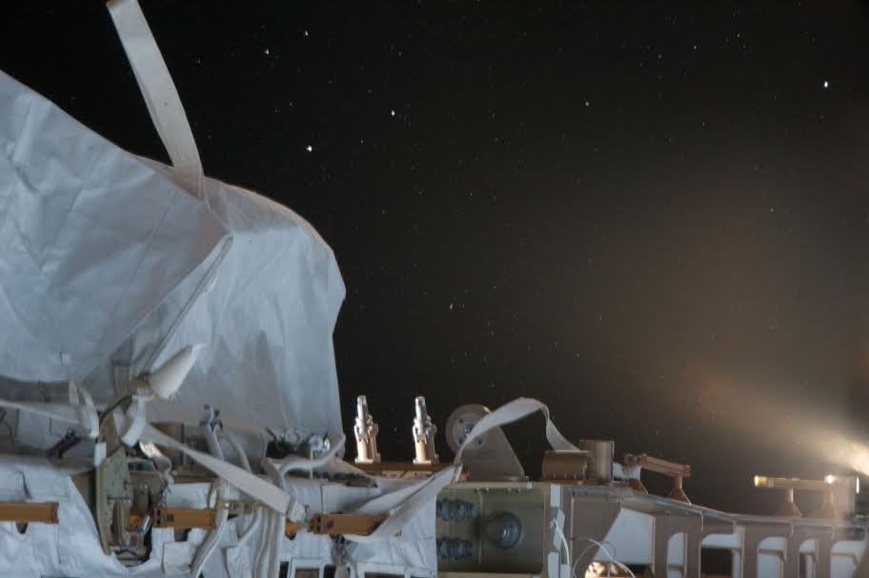
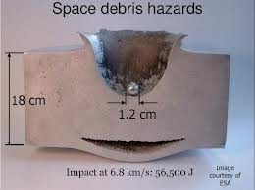
Intended Application
MAE - 252
Inspection
Look for impacts
Micrometeorites
Space “junk”
Monitor equipment failures
Mechanical malfunctions
Material faults
Leaks
University of California, Davis – Department of Mechanical & Aerospace Engineering
March 9, 2015
2
Notes:
What if debris made airlock fail

Slide 3
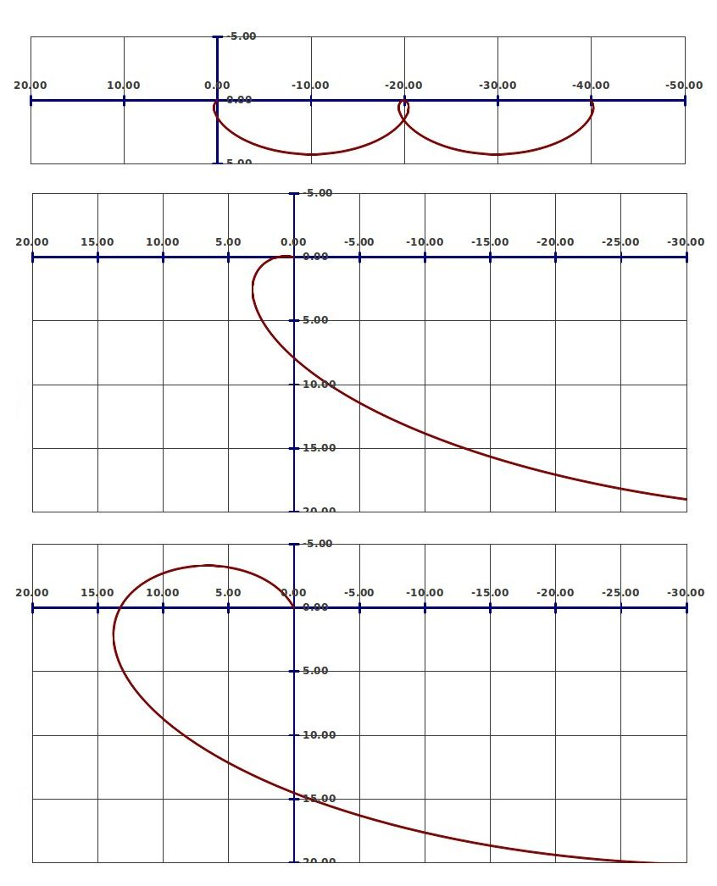
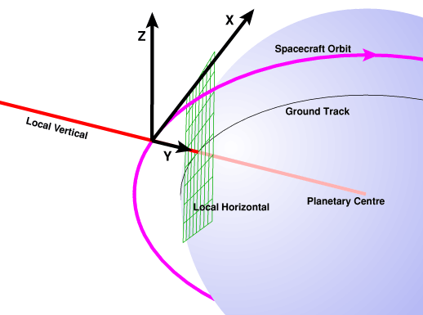
Problem Explanation
MAE - 252
What we would like to accomplish
Develop our simulation
Start with Clohessy-Wiltshire model
Test with ideal systems
Raise complexity and remove assumptions
Experiment with computer vision algorithm
Test multiple robotic architectures
v-bar and r-bar rendezvous approaches
University of California, Davis – Department of Mechanical & Aerospace Engineering
March 9, 2015
3
Notes:
Add figure description

Slide 4
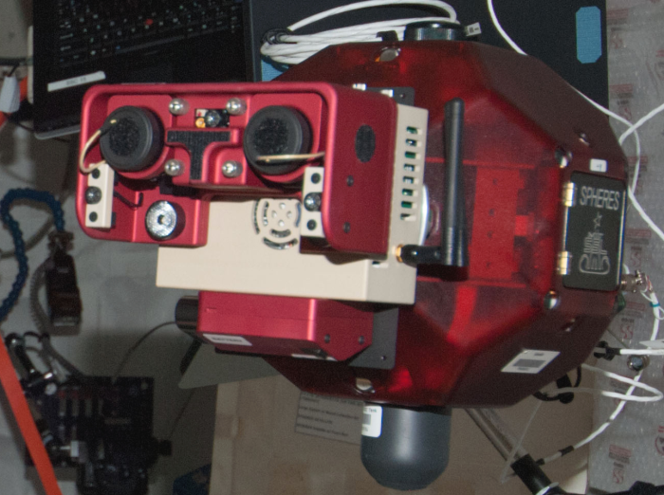
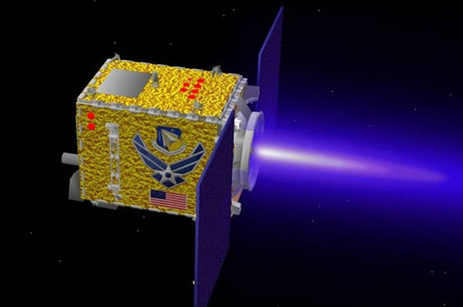
Inspector
MAE - 252
Outline of the autonomous inspector
Computer vision based navigation
One full color camera
Laser assisted range finding
Simple shape recognition algorithms
Used to determine pose
Assumptions
Unlimited power storage
Reaction wheels that never saturate
Laser has ranging error
Thrust is applied perfectly along all axes
Thrust has magnitude error
University of California, Davis – Department of Mechanical & Aerospace Engineering
March 9, 2015
4

Slide 5
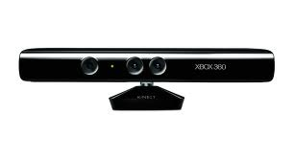
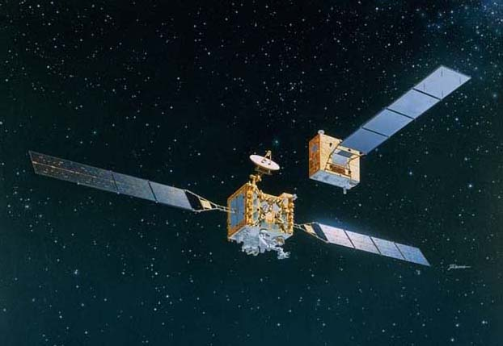
Vision based navigation
MAE - 252
Why use it?
Can quickly collect large amounts of data
Can determine attitude and position relative to target
Can use same cameras for other tasks (inspection or science mission)
More data and increased accuracy with two images
Can take video or just images depending on current task
Technology readiness level
Smaller test satellites already demonstrating advanced computer vision and navigation methods
Has already been used as primary method of navigation for autonomous docking
Camera technology allows lower costs and smaller size than ever before
University of California, Davis – Department of Mechanical & Aerospace Engineering
March 9, 2015
5
Notes:
Orbital Express
Engineering Test Satellite VII
SPHERES w/ VERTIGO
SPHERES w/ Tango

Slide 6

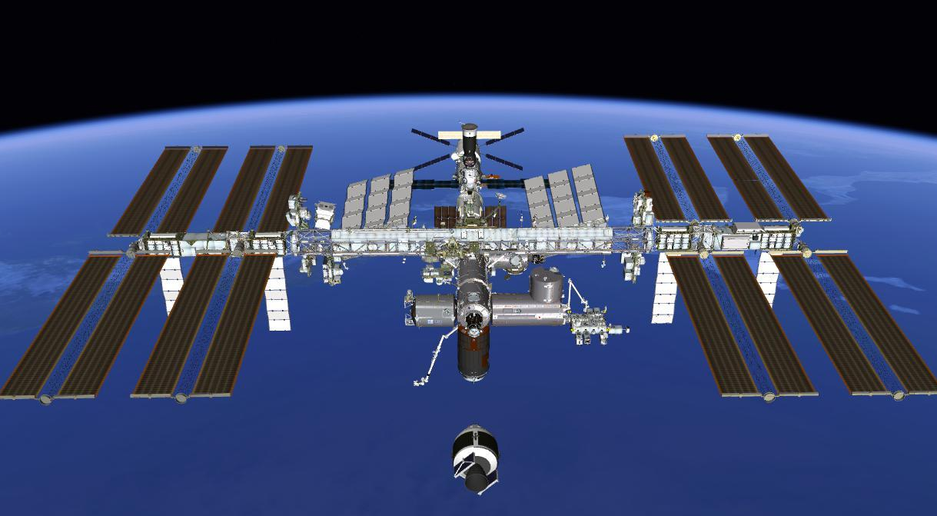
Simulation
MAE - 252
Python and EDGE
Python
High level and low level control architectures
Hierarchical/deliberative paradigm
Sense -> Plan -> Act
Reactive/fuzzy paradigm
Sense -> Act
Model multiple sensors
EDGE
Model ISS, spacecraft
Various lighting effects and distributions
Cameras
Use dcomm to update positions, and send pictures to Python
University of California, Davis – Department of Mechanical & Aerospace Engineering
March 9, 2015
6

Slide 7
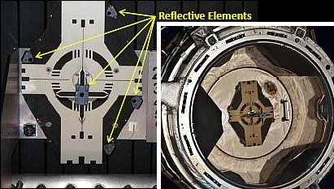
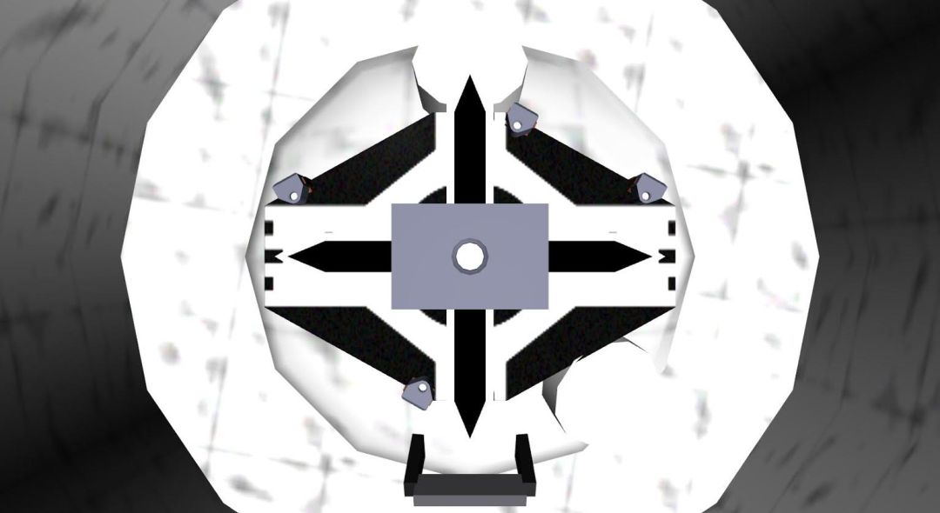
Target
MAE - 252
Outline of the target vehicle with docking port
Docking port
4 uniquely arranged target objects
Extended center marker
Highly visible, high contrast paint scheme
Assumptions
Constant attitude
(Nadir always towards Earth’s center)
Fixed circular orbit
Uncooperative
University of California, Davis – Department of Mechanical & Aerospace Engineering
March 9, 2015
7

Slide 8
Measured Performance Metrics
MAE - 252
How are we quantifying success?
Performance Metrics
Total Fuel Burned (per Trial)
Total Time of Flight (per Trial)
Error relative to Exact Laser Range Finder
Answered Questions
What is the tradeoff between total fuel burned and the total time of flight?
What is the relative performance between deliberative and reactive control architectures in an autonomous docking simulation?
University of California, Davis – Department of Mechanical & Aerospace Engineering
March 9, 2015
8

Slide 9
Deliberative Architecture Algorithm
MAE - 252
Sense:
Sense the estimated position using the specified sensor
Plan:
Determine the correct orbital maneuver and calculate the burn
Act:
Perform the calculated burn and move the inspector craft
Set Sensor:
Laser (exact)
Laser (noise)
Computer Vision
Determine Orbital Maneuver:
Final Approach:
distance ≤ 127 cm
burn time = 0.2 s
Closing:
distance ≤ 1270 cm
burn time = 1.0 s
Homing:
burn time = 5.0 s
Fire thrusters
Update Position using Clohessy-Wiltshire Equations
Determine Estimated Position
Calculate ΔV
University of California, Davis – Department of Mechanical & Aerospace Engineering
March 9, 2015
9

Slide 10
Reactive Architecture Algorithm
MAE - 252
Sense:
Sense the estimated position using the specified sensor
Act:
Perform the calculated burn and move the inspector craft
Set Sensor:
Laser (exact)
Laser (noise)
Computer Vision
Calculate Behaviors:
Move Closer
Don’t Hit
Station Keeping
Stay on Orbit
Return to Plane
Determine Estimated Position
Calculate ΔV
Fire thrusters
Update Position using Clohessy-Wiltshire Equations
University of California, Davis – Department of Mechanical & Aerospace Engineering
March 9, 2015
10

Slide 11
MAE - 252
Feature detection algorithm
We take a picture and use the values of the pixels to add in clever ways.
Take two pictures:
one with lights on
one with lights off
Subtract the two images
Filter resultant image
Find contours
Sort contours
University of California, Davis – Department of Mechanical & Aerospace Engineering
March 9, 2015
11

Slide 12
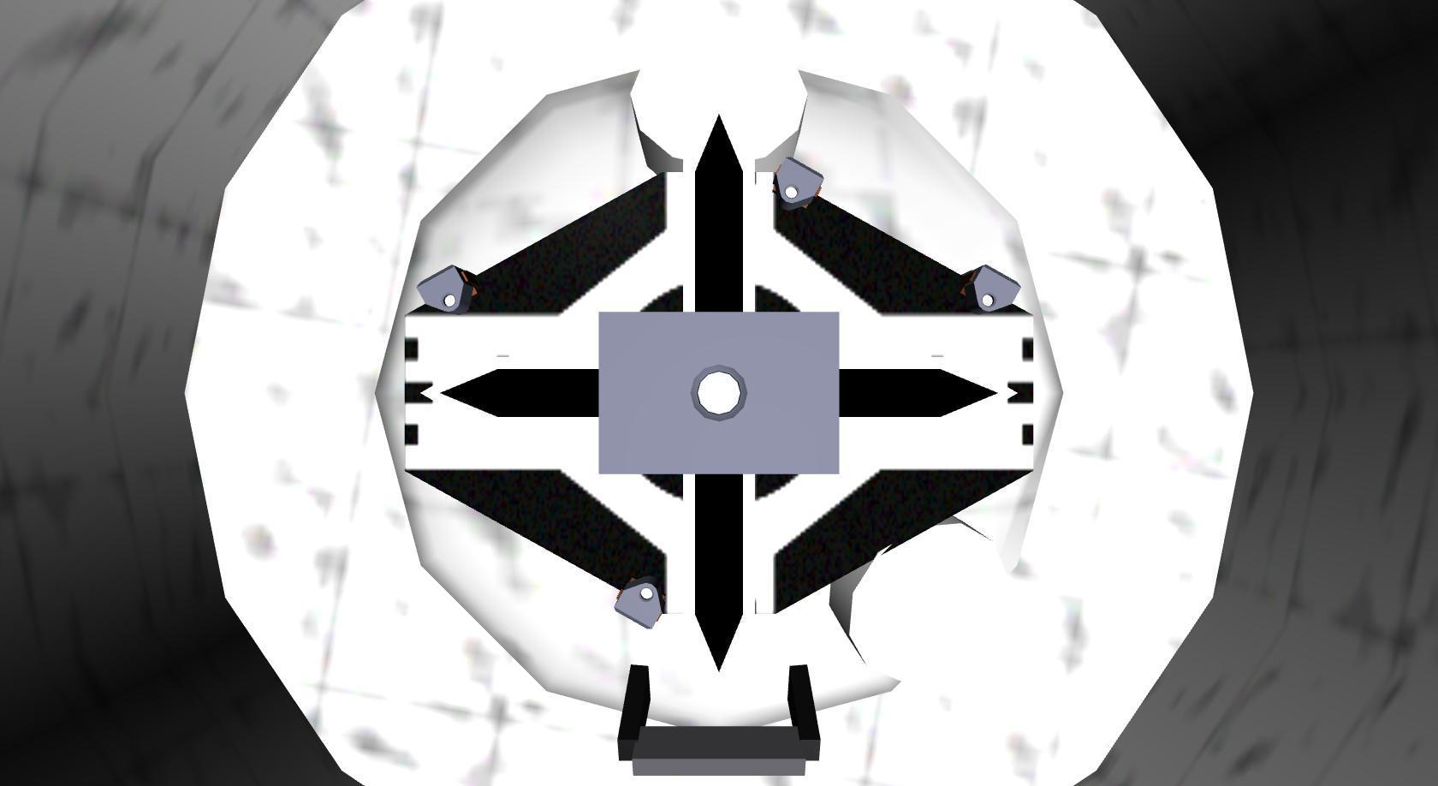
MAE - 252
University of California, Davis – Department of Mechanical & Aerospace Engineering
March 9, 2015
12

Slide 13
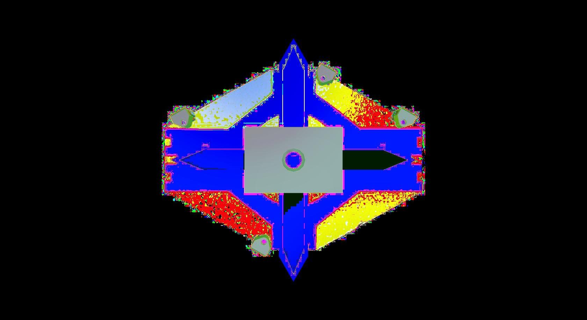
MAE - 252
University of California, Davis – Department of Mechanical & Aerospace Engineering
March 9, 2015
13

Slide 14

MAE - 252
University of California, Davis – Department of Mechanical & Aerospace Engineering
March 9, 2015
14

Slide 15
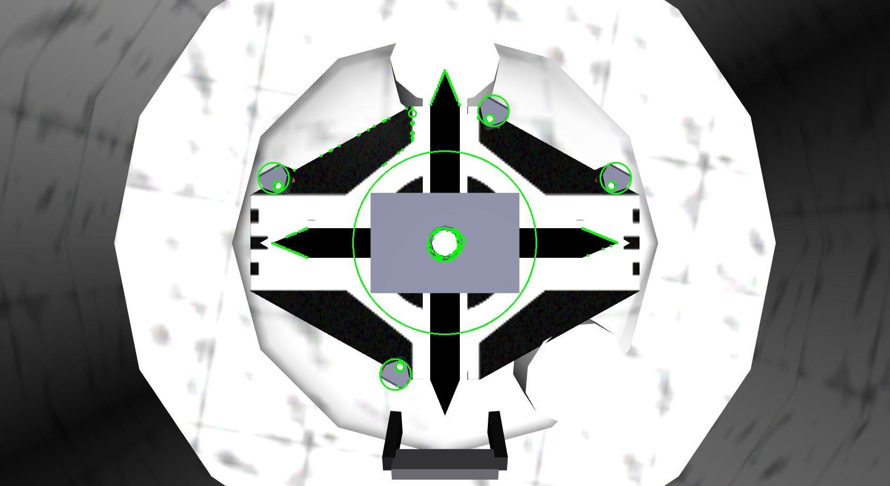
MAE - 252
University of California, Davis – Department of Mechanical & Aerospace Engineering
March 9, 2015
15

Slide 16
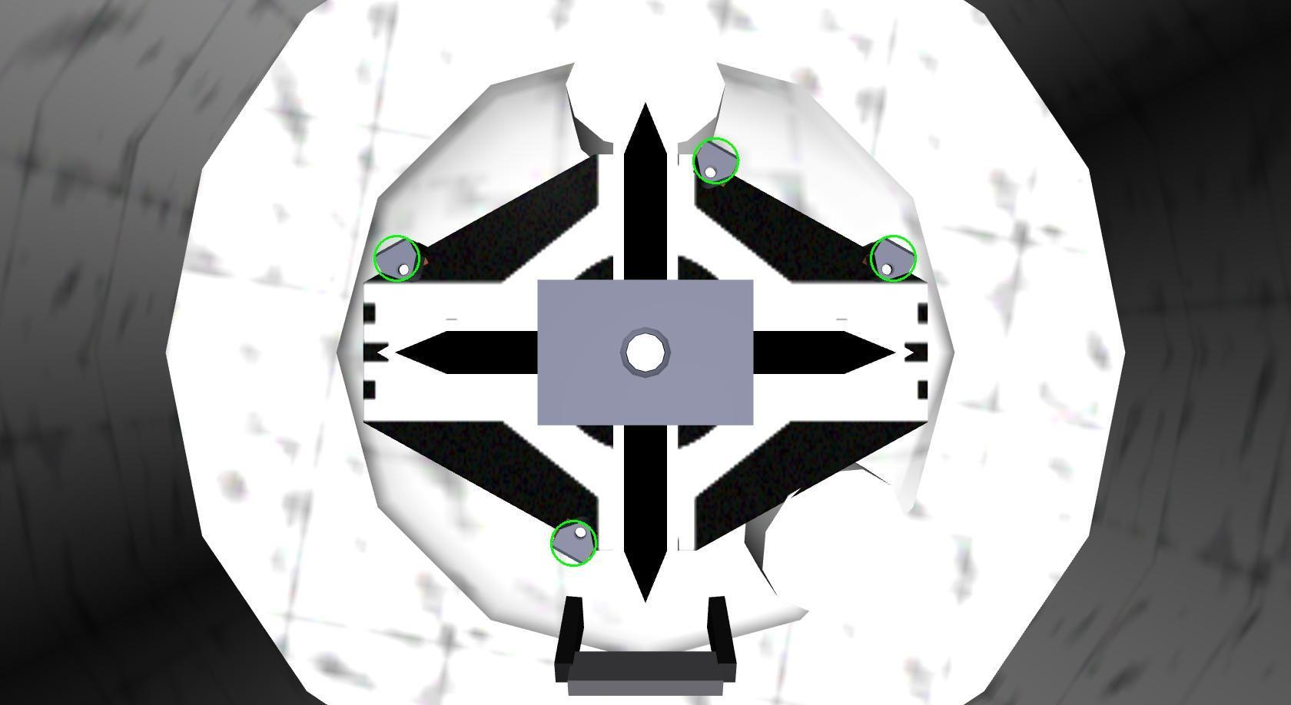
MAE - 252
University of California, Davis – Department of Mechanical & Aerospace Engineering
March 9, 2015
16

Slide 17
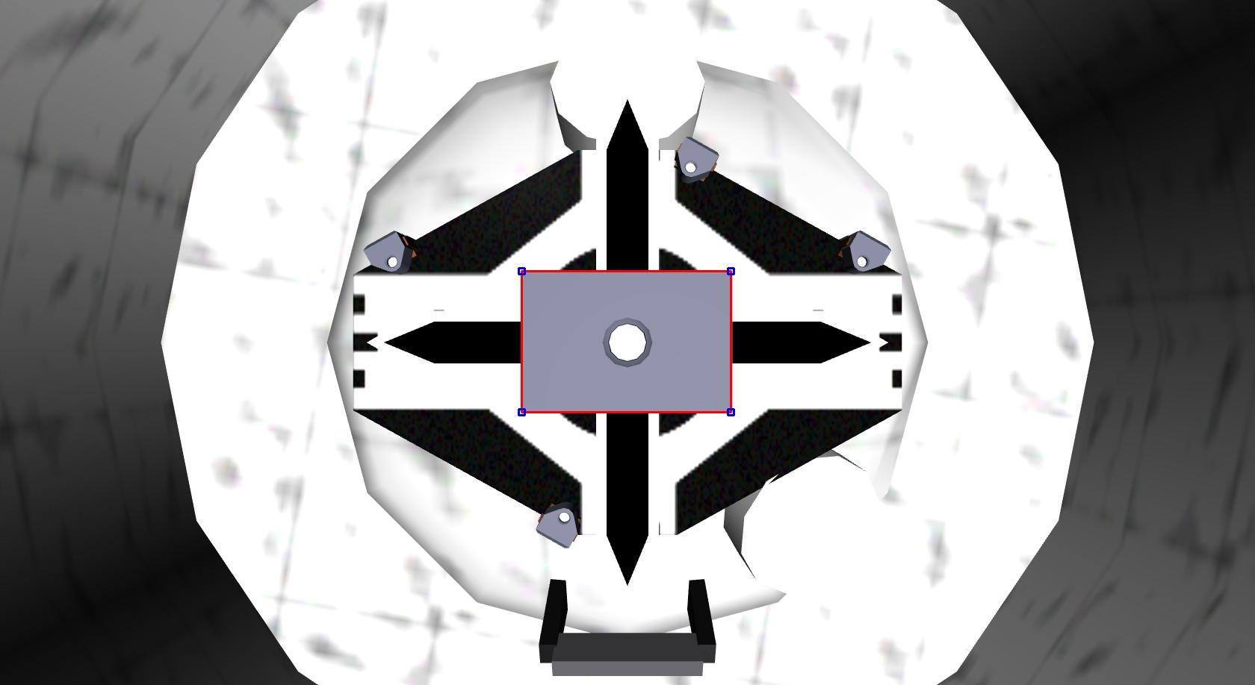
MAE - 252
University of California, Davis – Department of Mechanical & Aerospace Engineering
March 9, 2015
17

Slide 18
MAE - 252
Perfect ‘Laser’ Results (N=100)
 |  |  | Deliberative |  | Reactive
x (cm) | y(cm) | z(cm) | Time (s) | Fuel (cm/s) | Time (s) | Fuel (cm/s)
100 | 0 | 0 | 94.6 | 2.55 | 104.5 | 4.95
 | 50 | 37 | 181.7 | 2.55 | 191.7 | 9.74
300 | 0 | 0 | 294.8 | 2.56 | 304.6 | 5.01
 | 50 | 37 | 381.6 | 2.61 | 391.7 | 9.64
500 | 0 | 0 | 495.0 | 2.57 | 504.7 | 5.05
 | 50 | 37 | 581.6 | 2.58 | 591.7 | 9.42
University of California, Davis – Department of Mechanical & Aerospace Engineering
March 9, 2015
18

Slide 19
MAE - 252
Laser Results (N=100)
 |  |  | Deliberative |  | Reactive
x (cm) | y(cm) | z(cm) | Time (s) | Fuel (cm/s) | Time (s) | Fuel (cm/s)
100 | 0 | 0 | 94.6 | 2.56 | 104.4 | 56.61
 | 50 | 37 | 181.6 | 2.56 | 191.1 | 309.99
300 | 0 | 0 | 294.8 | 2.58 | 304.6 | 62.53
 | 50 | 37 | 381.6 | 2.61 | 391.4 | 365.44
500 | 0 | 0 | 495.1 | 2.76 | 504.8 | 65.39
 | 50 | 37 | 581.6 | 2.75 | 591.3 | 395.83
University of California, Davis – Department of Mechanical & Aerospace Engineering
March 9, 2015
19

Slide 20
MAE - 252
CV Results (N=10)
 |  |  | Deliberative |  | Reactive
x (cm) | y(cm) | z(cm) | Time (s) | Fuel (cm/s) | Time (s) | Fuel (cm/s)
100 | 0 | 0 | 94.6 | 2.58 | 111.2 | 65.19
 | 50 | 37 | 181.6 | 2.57 | 200.0 | 141.47
300 | 0 | 0 | 294.8 | 2.61 | 312.0 | 72.84
 | 50 | 37 | 381.6 | 2.58 | 398.7 | 308.82
500 | 0 | 0 | 495.0 | 2.61 | 512.5 | 72.56
 | 50 | 37 | 581.6 | 2.65 | 599.6 | 116.65
University of California, Davis – Department of Mechanical & Aerospace Engineering
March 9, 2015
20

Slide 21
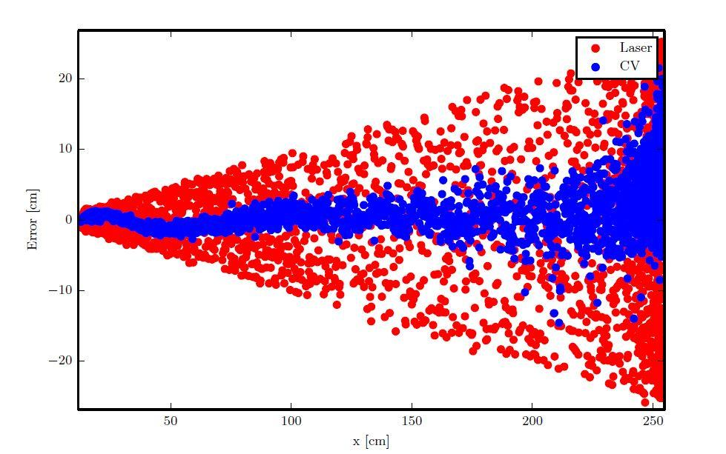
MAE - 252
Sensor Error Results
University of California, Davis – Department of Mechanical & Aerospace Engineering
March 9, 2015
21

Slide 22
MAE - 252
An example trial
Start at (x, y, z) = (254, 127, 94) [cm]
Reactive architecture on right
Deliberative architecture on left
Play video
University of California, Davis – Department of Mechanical & Aerospace Engineering
March 9, 2015
22

Slide 23
MAE - 252
Future Ideas
Hybrid Control Architecture
Increase performance during plan and act steps
Use reactive sub-architectures but with knowledge of environment
Further split burn weight determination scheme to make each axis independent
Kalman Filter
Minimize error of state vector determined during sense step
Can be used to combine both laser rangefinder and computer vision measurements
University of California, Davis – Department of Mechanical & Aerospace Engineering
March 9, 2015
23

Slide 24
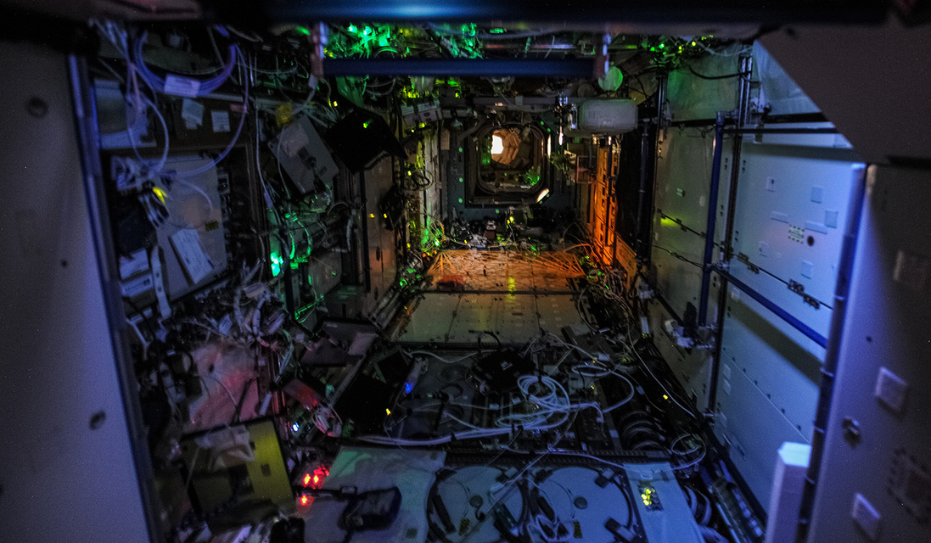
Questions?
MAE - 252
University of California, Davis – Department of Mechanical & Aerospace Engineering
March 9, 2015
24

